Slide 1
Accelerated Reader: A Guide for Teachers

Slide 2
The importance of reading

Slide 3
Accelerated Reader
Accelerated Reader is a new program designed to do the following things:
1) Find books that are the right ability for the child;
2) Encourage the child to read more;
3) Improve the child’s reading ability.

Slide 4
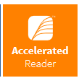
Two parts to the program
Notes:
https://ukhosted62.renlearn.co.uk/1892677/default.aspx If they can’t find it

Slide 5
Star Reading
Need to discuss here how often children complete this
At the start of the year, some pupils in Year 2 as well as all pupils in Year 3 to Year 6 took a Star Test, which is a computer-based test that measures a student’s reading ability through a series of 34 questions.
Every test for every student is different, and the computer selects different questions for each student dependent on how well they answer the previous questions. Essentially, the computer adapts the test to suit your child.
Notes:
https://ukhosted62.renlearn.co.uk/1892677/default.aspx If they can’t find it

Slide 6
How STAR tests work
The student must take their time. It is recommended that each child should spend at least 20 minutes on their tests.
2) Students should not guess answers to questions. Instead, they should wait for the question to time out. This is to ensure the computer is not given a false impression of the student’s reading ability.
3) Tests are done independently.

Slide 7
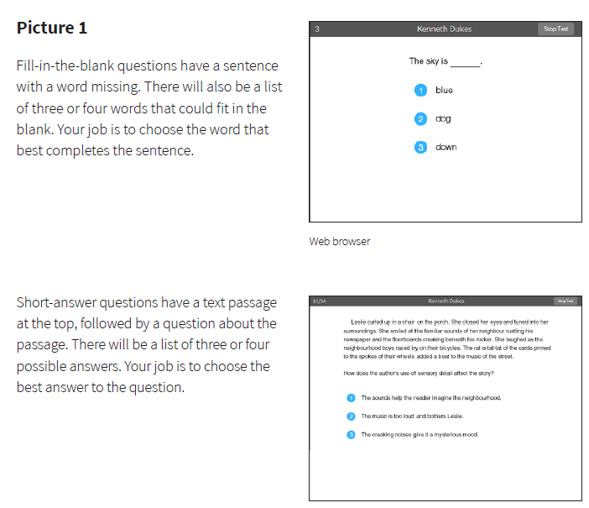

Slide 8
ZPD score (Zone of Proximal Development)
After each Star Reading test, children are given a ZPD range, which is two numbers that the pupil uses to choose their next reading book.
The lowest number is the lowest level of book the pupil should be choosing.
The highest number is the highest level of book the pupil should be choosing.
Pupils keep a record of all their ZPDs in their planners.
A new STAR test takes place every half term, so students can see improvements in their reading ability, but also choose more challenging books.
3.2 – 4.6
Lowest number
Highest number

Slide 9
Reading books
Pictures of new books and children reading

Slide 10
Accelerated Reader books

Slide 11
Accelerated Reader books
We have spent over £10,000 on reading books from children in Year 2 to Year 6. This comprises of brand new books for fiction and non-fiction texts.
Pictures of our new books

Slide 12
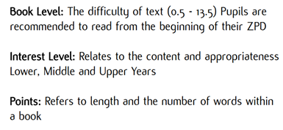
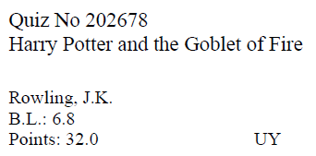
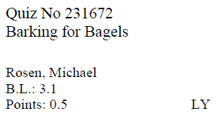
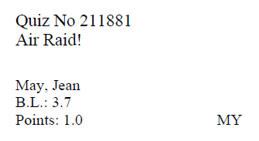
Accelerated Reader books

Slide 13
Accelerated Reader books
How we will use AR in school
Timings
Books
How books are to be returned
Reports to use

Slide 15
Accelerated Reader quizzes
A quiz is taken after a book has been read.
There are usually about 10 multiple choice questions on the book. At the end of the quiz the pupils are given a percentage to show them how well they have done. Generally they need a pass rate of 60% or higher to earn the points.
Points are based on pro rata basis depending on how well they do on their reading comprehension quiz.
Some vocabulary practice quizzes can be taken as well.
There are some important rules for taking quizzes:
1) The quiz should take place within 24 hours of finishing the book if possible.
2) A student cannot take a quiz until they have read the entire text.
3) Quizzes must be done individually, not with anyone’s help.

Slide 16
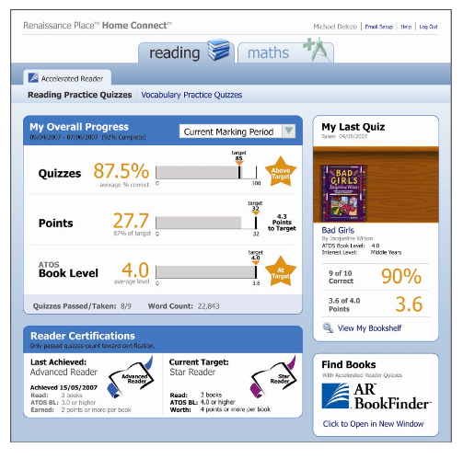
How will I know how my child is doing?
You can access your child’s AR information in Renaissance Place Home Connect from any web-enabled computer.
Once in the programme, you can view your child’s progress towards targets, points and books read.
You can also access AR BookFinder to search for titles of interest.

Slide 17
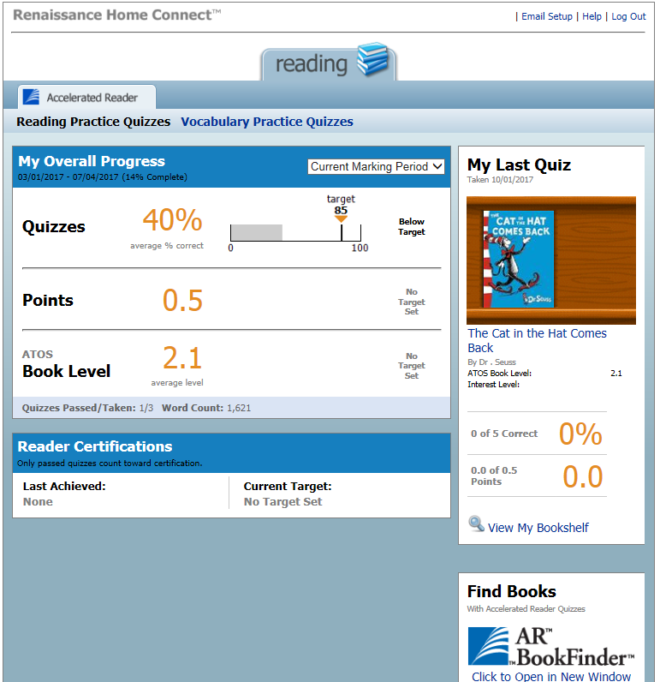
Average quiz score
Points earned
Average book level.
Last book read and quizzed on. Include % correct and points earned from book.

Slide 18
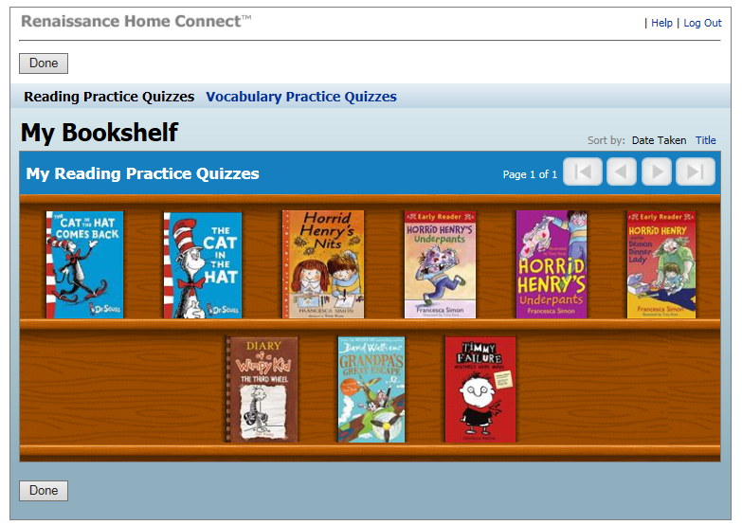
Your child’s bookshelf

Slide 19
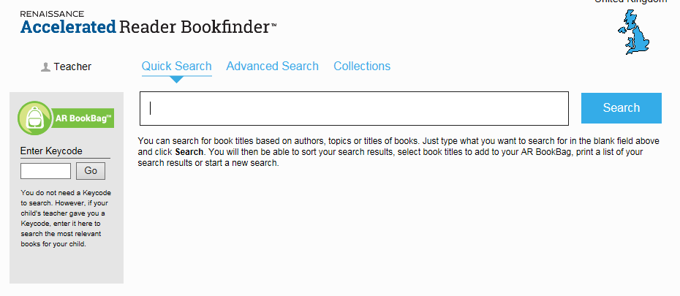
www.arbookfind.co.uk

Slide 21
Any Questions ?

